Slide 1
Seeking the perfect neighborhood to open a new Mediterranean restaurant in Los Angeles
Final Course Project for the IBM Data Science Professional Certificate

Slide 2
Introduction
Mr. Alexopoulos is a Greek chef whose wife Gabriella has been offered a marvelous job as co‑editor in an emerging fashion magazine. The office is located in Los Angeles, but neither of them have gotten to know this huge and widespread city, but both know that it has a lot of business opportunities.
Objectives: The main purpose of this study is to make use of the available data to create an initial food and restaurant business map of the Los Angeles city that can help the client select the ones in which his new restaurant can be more successful and the best clients

Slide 3
Methodology
Descriptive approach through clustering
Data
List of Neighbourhoods (Wikipedia)
Geolocation (Geocoder package)
Places information (FourSquare)
Workflow
Stage 1:
Gathering the data of neighborhoods and their geolocation
Stage 2:
Extract places information from the FourSquare API and make sense of categories
Stage 3:
Use machine learning and data analysis tools from the gathered data to answer

Slide 4
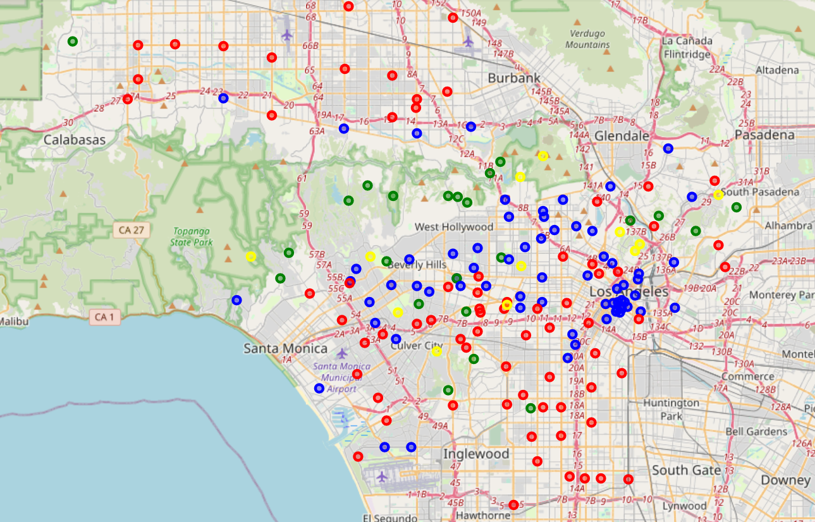
Results
Clustering of 4 types of neighborhoods using k-means
Type 1 (red): Residential
Type 2 (blue): touristic

Slide 5
Results & discussion
Clustering of 4 types of neighborhoods using k-means
Type 1 (red): Residential
Type 2 (blue): touristic

Slide 6
Results & discussion
Clustering of 4 types of neighborhoods using k-means
Type 1 (red): Residential
Type 2 (blue): touristic

Slide 7
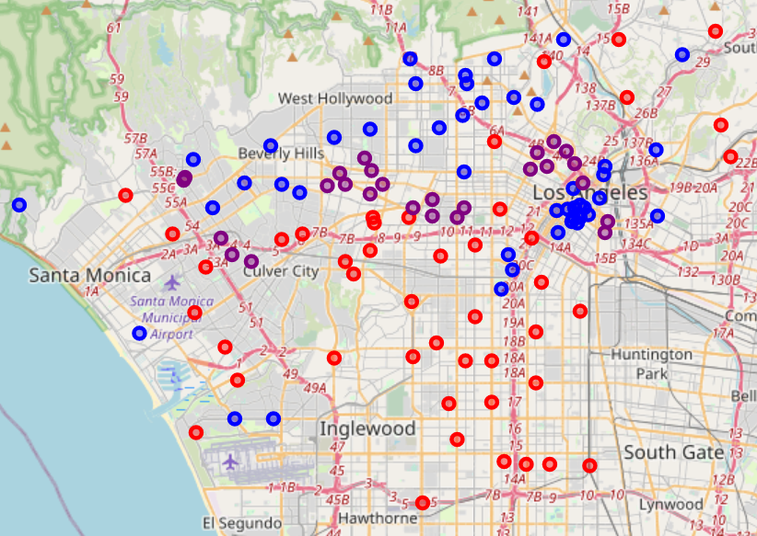
Conclusion

